Slide 1
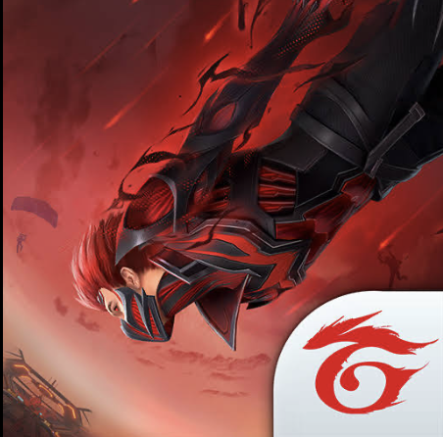

A Deep Dive into the Technical Aspects of Free Fire
Reporter: D.HOMESH
Register num: 192324116

Slide 2
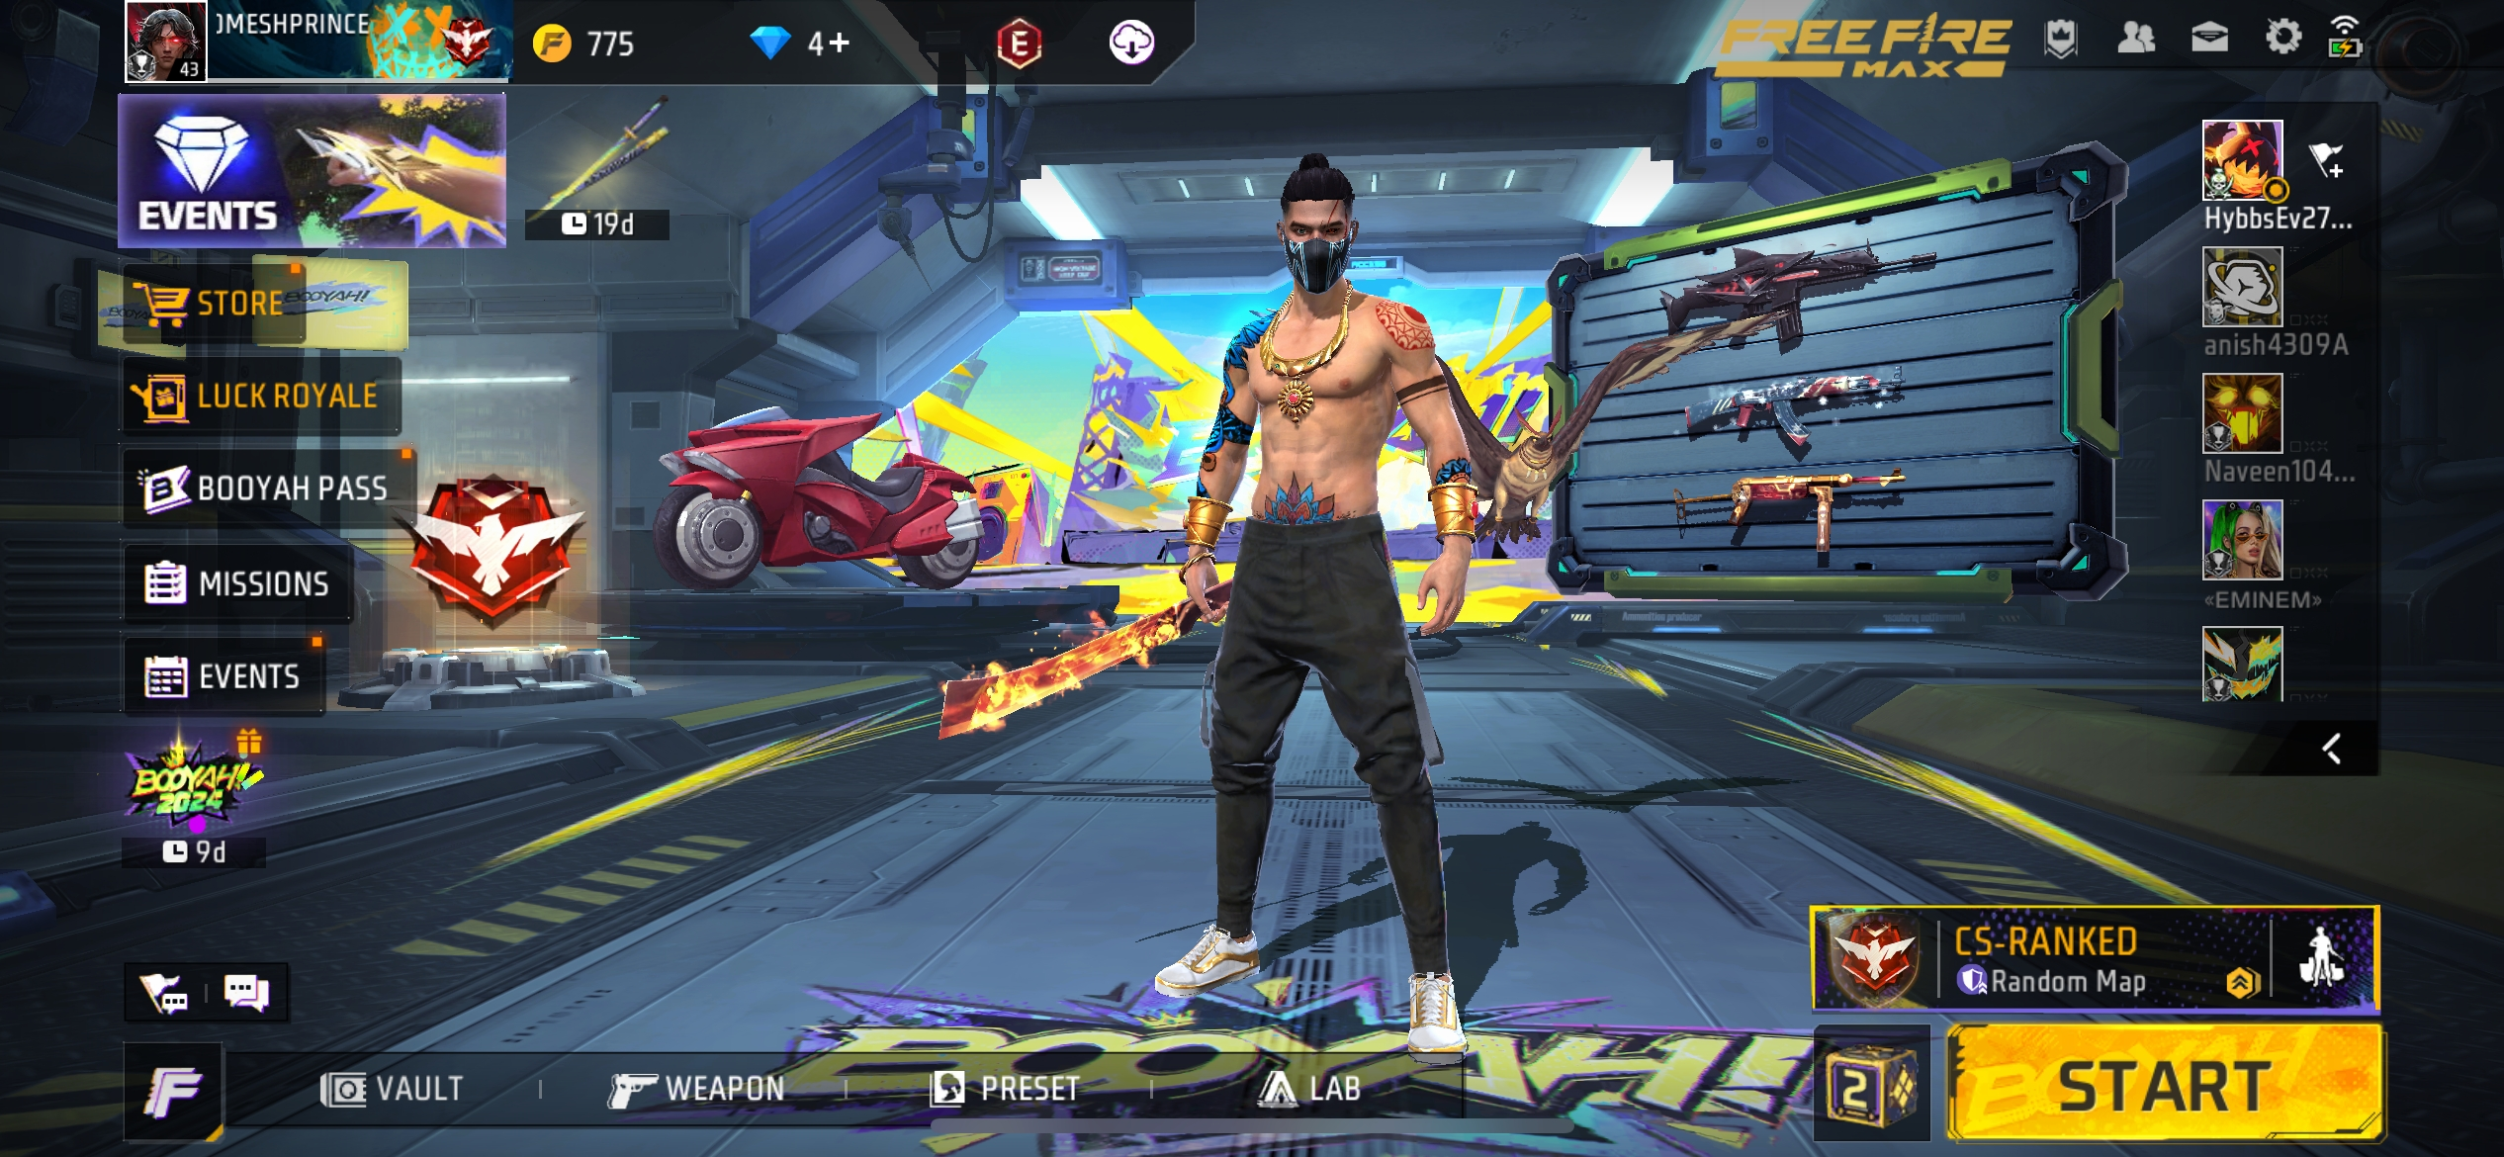
Introduction To Free Fire
Free Fire is a popular online multiplayer battle royale game developed and published by Garena.
Released: 2017
Genre: Battle Royale, Multiplayer Online
Overview of its gameplay mechanics and success in the mobile gaming industry.

Slide 3
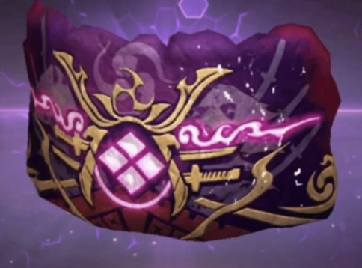
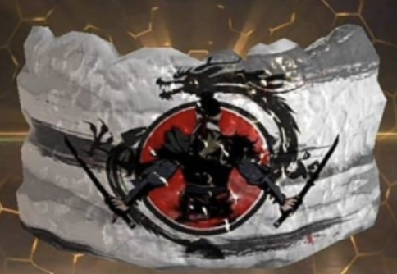
Overview of Front-End in Free Fire
Game Engine: Developed using Unity 3D with C# for scripting.
3D Models & Textures: Created using Blender or 3ds Max and optimized for mobile performance.
UI/UX Design: Designed using tools like Adobe XD and integrated into Unity.
Game Logic: C# scripts handle character movement, interactions, and UI management.
Unit Testing: Using *Unity Test Runner.
Functional Testing: Manual and automated testing.
Performance Testing: Monitored via Unity Profiler.
Cross-Platform Testing: Ensures compatibility on both Android and iOS.
Challenges: Optimizing for low-end devices and responsive touch controls.

Slide 4


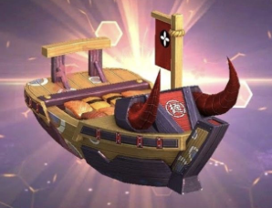
Overview of Back-End in Free Fire
Game Server Architecture: Uses a client-server model, where the client handles the UI and player input, while the server manages game state, match-making, and multiplayer synchronization.
Server-Side Technologies:
C++ for game logic and performance optimization.
Node.js for handling APIs and real-time data.
Cloud Platforms (e.g., AWS, Google Cloud) for scalability and low-latency connections.
Database Management: Uses MySQL or NoSQL (e.g., MongoDB) for storing player data, stats, and game progress.
Matchmaking: Algorithms match players based on region, skill, and rank.
Latency Optimization: Distributed server instances to reduce lag and ensure smooth gameplay.
Security: Anti-cheat systems, data encryption, and DDoS protection.
Real-Time Synchronization: Ensures all players experience the game state in real-time.

Slide 5

Challenges in Developing Free Fire
Performance on Low-End Devices: Optimizing graphics, reducing file size, and ensuring smooth performance on less powerful devices.
Real-Time Multiplayer Synchronization: Ensuring lag-free, real-time interaction between thousands of players.
Cheating Prevention: Developing and updating anti-cheat systems.
Server Load Management: Scaling up and managing resources to handle millions of concurrent players.Free Fire’s backend system is designed to handle large amounts of traffic.
Horizontal Scaling: More servers are added as the number of users increases.
Load Balancing: Ensures players are matched to the server closest to them, minimizing lag and server overload.
Latency Optimization: Various techniques to reduce the ping time during gameplay, making the game responsive and enjoyable.
Version Control: Tools like Git are used for managing code and collaboration between development teams.
User-Centric Design: Focus on usability, accessibility, and intuitive controls for all player demographics.

Slide 6
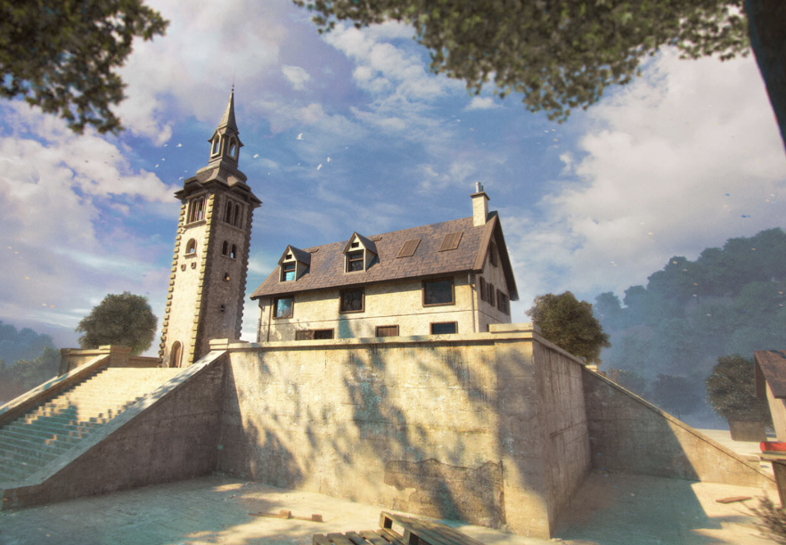
Conclusion
Free Fire is a highly optimized and successful mobile game that combines complex front-end and back-end engineering.
Its success is due to the seamless integration of real-time multiplayer systems, cloud architecture, and game design.
Software engineering best practices such as agile development, continuous updates, and optimization ensure that the game remains a leader in the mobile gaming industry.

Slide 7
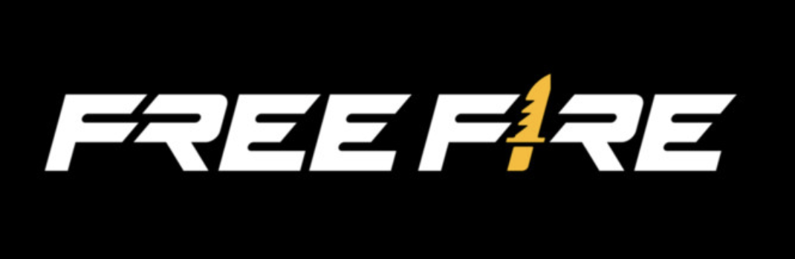

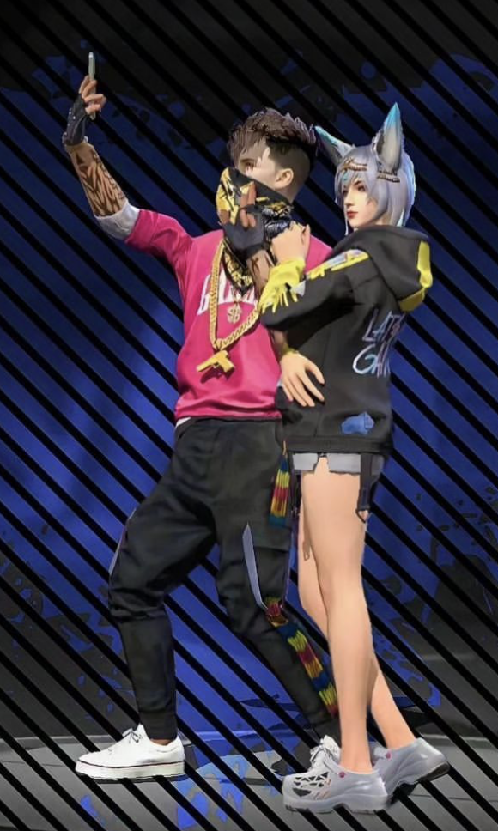
THANKYOU

